Slide 1

Artificial Intelligence
Machine Learning
Deep Learning
Limitations of machine learning
How deep learning solves it?
Real-life use cases of deep learning
How deep learning works?
Biological Neuron
Perceptron
Weights & Bias
Activation Functions (types)
Perceptron Use Cases
Training a perceptron
Optimization
Learning Rate
Epoch
Backpropagation
Limitations of perceptron
Intuition for MLP
Backpropagation for MLP
Deep Learning Architecture

Slide 2
Artificial Intelligence & Machine Learning
Artificial Intelligence
Machine Learning
Deep
Learning

Slide 3
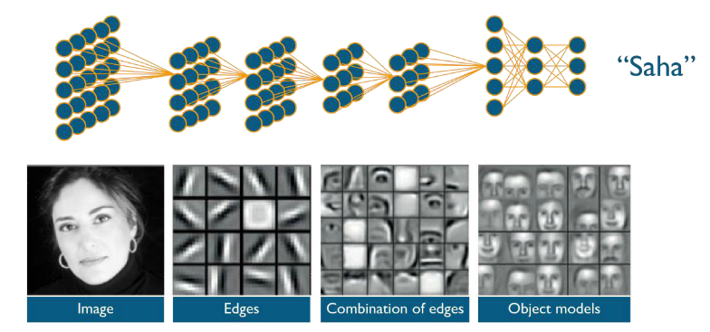
How deep learning solves it?

Slide 4
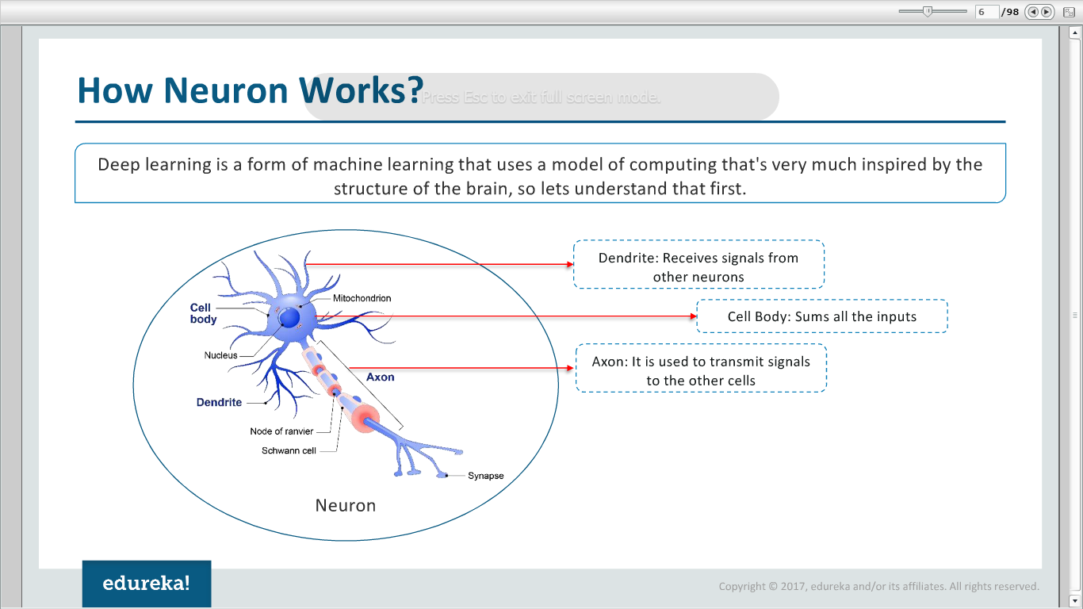
Biological Neuron

Slide 5
Optimization - 1

Slide 6
Optimization - 2

Slide 7
Intuition for MLP
7x – 3y = -9
2
7
5x – 4y = 1

Slide 8
Backpropagation for MLP - 1
Input | Desired Output
0 | 0
1 | 2
2 | 4

Slide 9
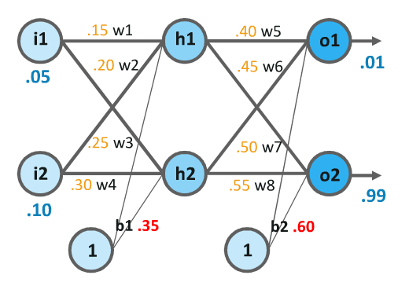
Backpropagation for MLP - 2

Slide 10
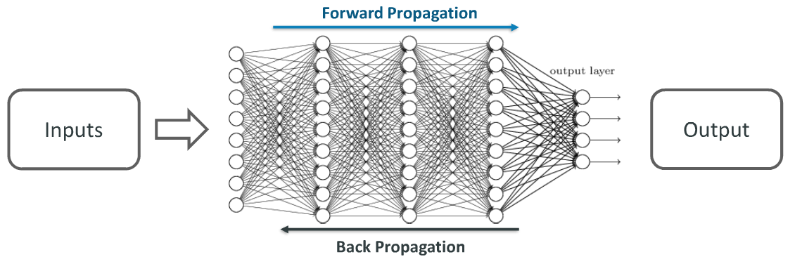
Deep Learning Architecture

